Slide 1
Anzac
Is sad
People are dying
Bullets passing by people
Walking in wet mud
Writing family letters
Blood everywhere
War.

Slide 2
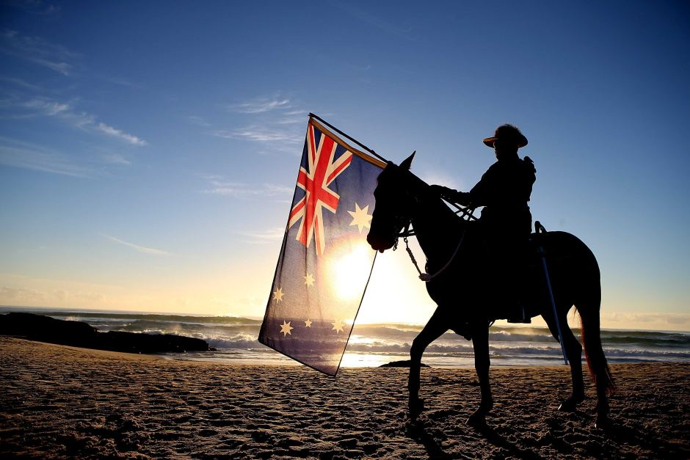
ANZAC
People fighting
For our county
People risking their lives
To save our country
We love to
Remember Anzac
day

Slide 3
Anzac
So Sad.
Writing some letters.
As bullets fly by
I start to cry
Australia New Zealand
Army Corps.
War.

Slide 4
Anzac
Is sad
I feel bad
Blood in the mud
Bullets in the ear
I am scared
Help them
Poppies

Slide 5
Anzac
day is
Sad for all
The lost and bloody
Bullets hitting the ground
Death beside me
No more
death

Slide 6
Poppies
Army
Hugs, kisses
Happy smiles everywhere
Tears down people's faces
big bangs of bullets
Friend say bye
Love forever
Anzac

Slide 7
Anzac
Is sad
My knees tremble
With the scary war
Right by my feet
At the thought
Of war
Poppies

Slide 8
Anzac
Big tears
On my face
Anzac is to remember
The soldiers that died
In the war
Im sorry
Soldiers

Slide 9
Anzac
Is death
Where bullets fly
Bloods pouring out everywhere
Friends die horrible deaths
But poppies bloom
Inside Anzacs
Shadow.

Slide 10
Anzac
Is scary
Pretty poppies blossom
It is very muddy
People died beside me
It is sad
I’m scared
Anzac.

Slide 11
Anzac Is scary Bullets zooming past My blood dripping face Dropping to the ground Landing in mud No longer ALIVE

Slide 12
Poppies,
Flying everywhere,
Soldiers dying bravely,
Each soldier very brave,
Soldiers living their lives,
Laying in peace,
Bullets fired,
sniper.

Slide 13
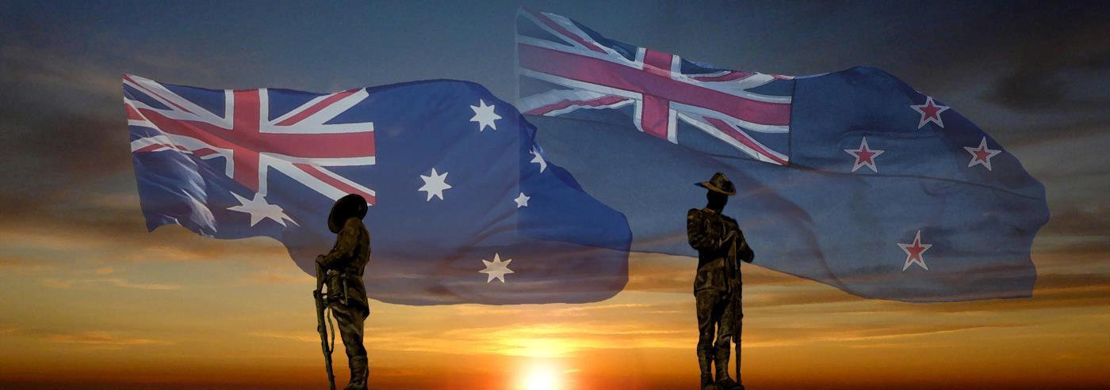
Anzac
People dying
The tank shoots
A tower is dust
The tank rolls on
Walking in mud
Everything soaked
Poppies

Slide 14
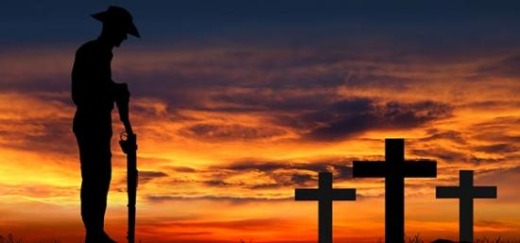
Anzac
Boom Boom
Tanks firing missiles
Bullets firing really fast
It is very noisy
People dying slowly
People passing
Death

Slide 15
Anzac
Is sad
Poppies slowly growing
People were in fear.
Bombs blowing up dirt.
Bullets zooming everywhere
It’s scary.
WAR

Slide 16
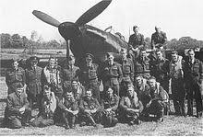
War
Warship Tanks
From the sky
Nukes dropping Gunshots fired
Lying in trenches
Wounded people
Death

Slide 17
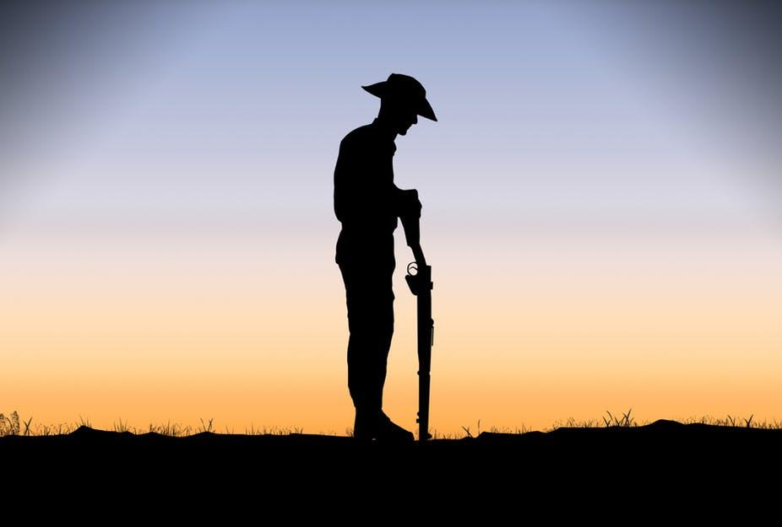
ANZAC
Anzac
Is blood
Pouring all out
Of the soldiers bodies.
As they walk over
The muddy trenches
So scary
Death

Slide 18
ANZAC
Sadly died
Loud banging noises
Sadly crying of death
All full of anger
Bang gun shots
Very horrifying
War

Slide 19
Anzac
An experience
That shocks all
But the war continues
The poppies bloom faster
As bullets pass
Soldiers fall
Love

Slide 20
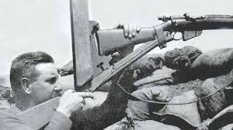
Anzac
Guns, bullets.
Warships, blood, rockets.
Tanks, helicopters, submarines, snipers
Death, world, war, New Zealand.
Camouflage, base, ammo.
Family, friends.
War.

